Slide 1
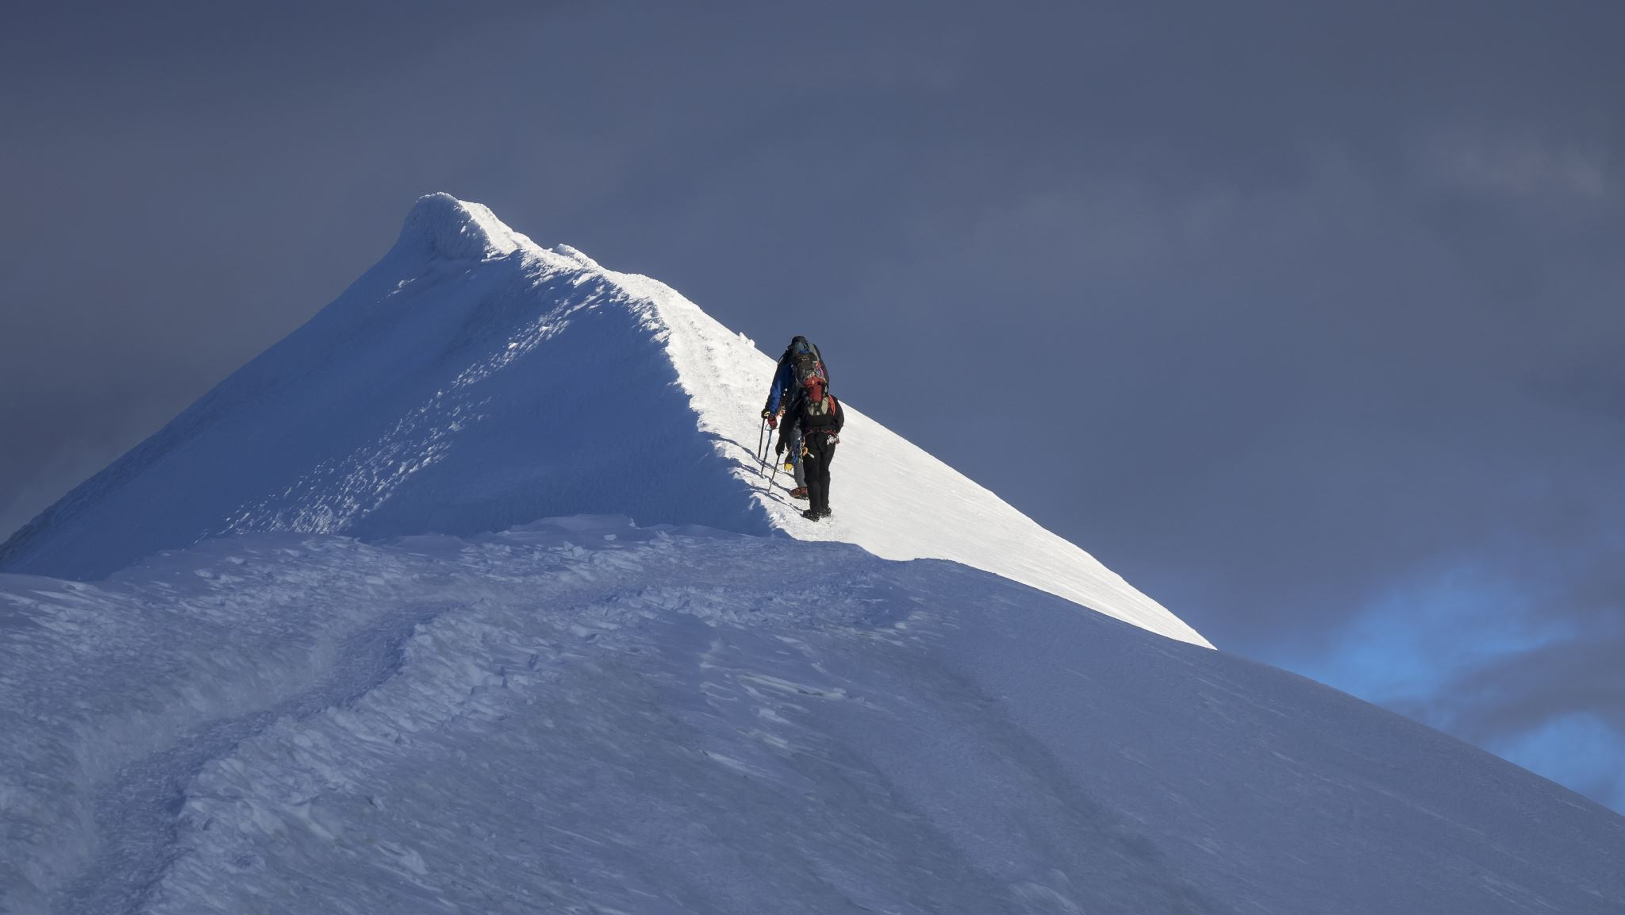
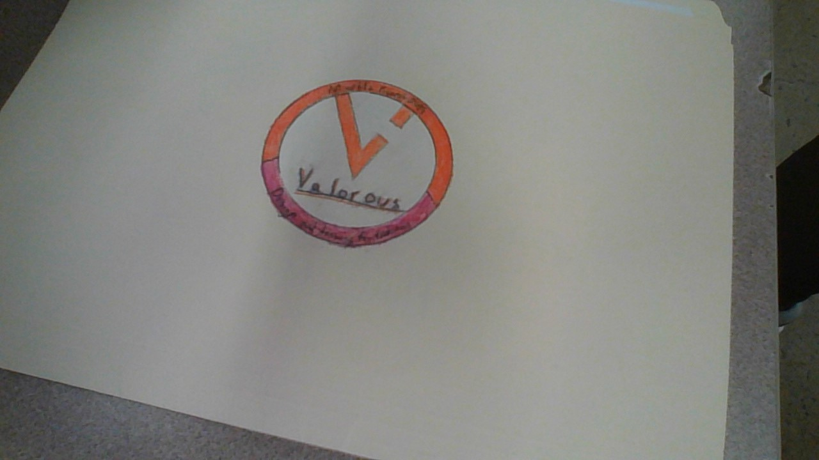
Valorous
Tate Finger and Quang Huynh

Slide 2
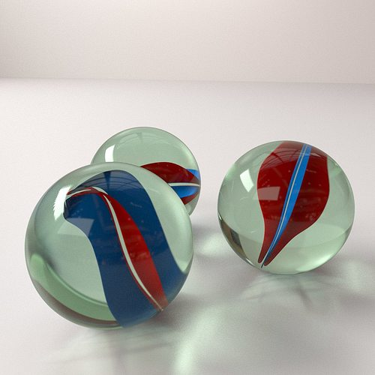
The goal
The goal of the project is to get a marble over a one-foot wall into a target. Each team gets limited resources and restrictions, such as dimensions of the project, and that an individual cannot lift with their hand. The marble must start from the base and a team must go over the wall.

Slide 3
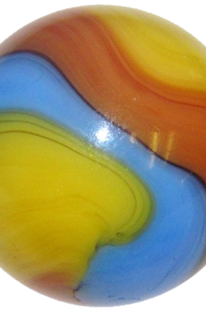
The goal (Cont.)
Our team will solve this problem by making a device that uses a pulley to drag a container, that holds the marble, over the wall and into the targets. The marble will fall out of a box through a hole and fall into a target.

Slide 4

Grade prediction
According to our device’s limits and mechanisms, the grade prediction is an
80%

Slide 5

What we would do differently
We should’ve thought of a better design, as we just picked a design that seemed easy at first, however it became problematic. We struggled a lot with our device’s accuracy, and that is why our grade prediction is an 80%.

